Slide 1
SOM DISTILLERY PRICE MOVEMENTS

Slide 2
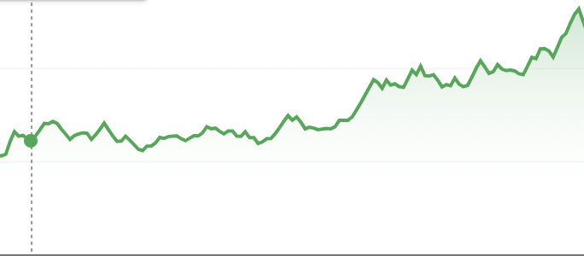
APRIL 1 TO SEPTEMBER 30
117
64.5
72
61
APRIL 1
APRIL 26
JULY 19
SEPTEMBER 30

Slide 3
ANALYSIS
Last 6 months –
Steady price with small daily fluctuations till July 19.
After quarterly update release with huge increase in sales on 20th July, there is continuous and significant rise in price till September 30.
But price remained constant and did not increase when quarterly update was released in April. This is because this update did not have tremendous performance by the company.
Next 6 months –
Price would remain constant more or less till quarterly update releases which are due in October and January. If company performance is exceptional in these updates, prices will increase significantly. If performance is normal, prices would remain stable.

Slide 4
SHORT NEWS ARTICLE
Based on last 6 months, SOM distilleries’ share price doesn’t change much and remains stable between quarterly earnings updates. Price is also stable when company performance is normal in these updates.
However, if the company performs well in quarterly report, market price increased tremendously and continuously for 2 months. So, invest on the day of quarterly updates if company performance is great in those updates!

